Slide 2
Unit 5: Functions (6hrs)
Introduction
Importance of functions
Returning a value from a function and sending a value to a function
Function prototypes
Calling a function- Call by value and Call by reference
Recursive functions
Passing an array to a function
Local variables, formal parameters, and global variables
Storage classes
Pre-processor directives- C libraries, macros, and header files

Slide 3
Passing Arrays To Function
Rules for passing an array to function:
The function must be called by passing only the name of the array.
In the function definition, the formal parameter must be an array_type, the size of the array need not to be specified.
The function prototype must show that the argument is an array.

Slide 4
Passing Arrays To Function
Syntax for function prototyping:
Return_type Function_name (datatype arrayname[]);
Eg: float Average (float Age[]);
Where Average is function name and Age is array name.
Syntax for calling or passing array:
Function_name (arrayname)
Eg: Average (Age);
Where Average is function name and Age is array name.

Slide 5
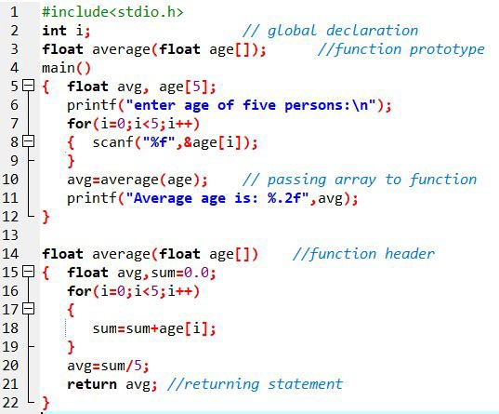
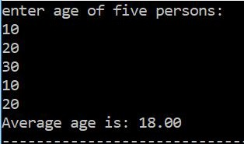
Passing arrays to function (Sample program)

Slide 6
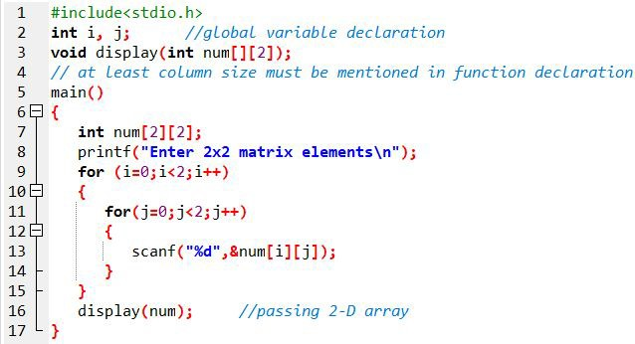
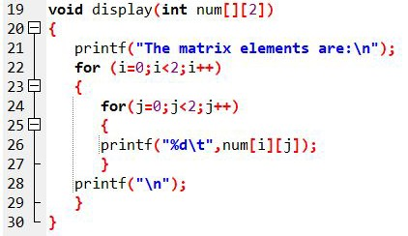
Passing arrays to function (Sample program)

Slide 7
Passing arrays to function (Sample program)
This signifies that the function takes a two-dimensional array as an argument. We can also pass arrays with more than 2 dimensions as a function argument.
When passing two-dimensional arrays, it is not mandatory to specify the number of rows in the array.
However, the number of columns should always be specified.
For example,
void displayNumbers(int num[][2]) {
// code
}

Slide 8
Passing structures to Function
Will be taught in next chapter

Slide 9
Scope of variable
Scope of variables refers to the region of the program where the defined variables can have its existence, and beyond that region, the variable cannot be accessed.
Mainly, there are two scopes of variable in C.
Local Scope
Variable scope confined within certain block
Global Scope
Variable scope is wide throughout the program

Slide 10
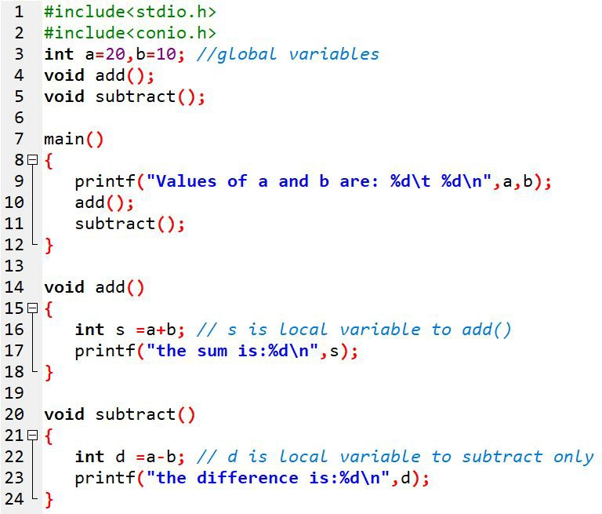
Global and Local scope
Here the variables ‘a’ and ‘b’ are global variables since they can be used by all the functions main(), add(), and subtract().
But ‘s’ is a local variable and has its local scope to function add() only. Likewise, ‘d’ has local scope within subtract() only.

Slide 11
Storage classes in C
A variable storage class provides the below information:
Storage location of variable.
Default initial value of variable if not specified.
Scope of variable (i.e. Visibility level).
Lifetime of variable (how long they exist).

Slide 12
Storage classes in C
S.N | Class | Storage | Default initial value | Scope | Lifetime
1. | Automatic | CPU memory | Garbage value | Local | Within the function
2. | Static | CPU memory | Zero | Local | Value persist until the end of program
3. | External | CPU memory | Zero | Global | Till the end of main() program
4. | Register | Register memory | Garbage value | Local | Within the function

Slide 13
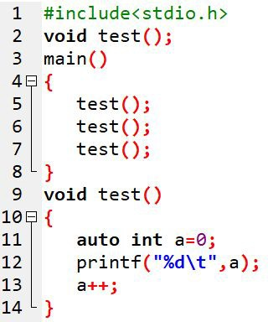

Automatic Storage class
Such variables are local to the block in which they are defined and
get destroyed on the exit from that block.

Slide 14
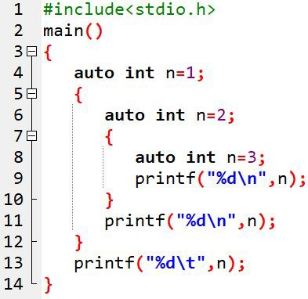

Automatic Storage class
Keyword used: auto
Default storage class

Slide 15
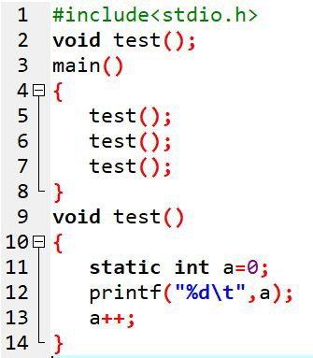

Static Storage class
Keyword used: static
Share the same memory
Accumulate the results

Slide 16
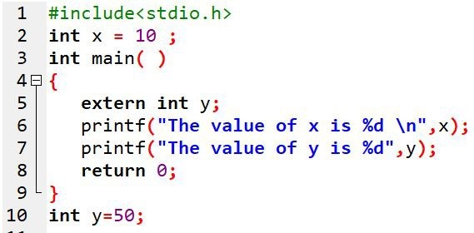

External Storage class
Keyword used: extern
Active and alive through out the entire program.
Also called global variables

Slide 17
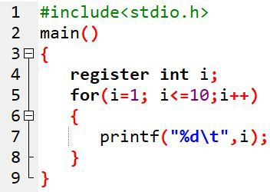
Register Storage class
Keyword used: register
Variables operate at CPU registers.
Faster accessing

Slide 18
Pre-processor directives
lines that are included in the code of programs preceded by a hash(#).
can be placed anywhere in the program.
But often before the main() function.

Slide 19
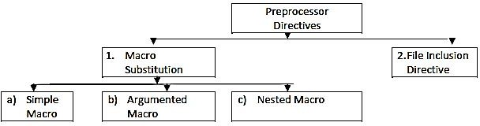
Pre-processor directives (Types)

Slide 20
1) Macro-Substitution Directive
This uses macros which replace the defined identifier in the program.
Such directives accomplish the task under the direction of
#define statement.
Classified into three categories namely:
Simple macro
Argumented macro
Nested macro

Slide 21
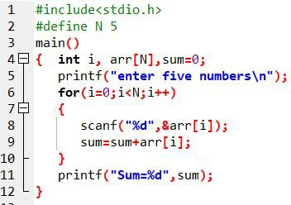
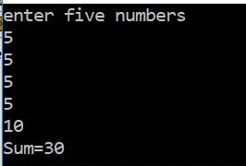
a) Simple macro
They are generally used for declaring constants in C programs.
General form is:
#define identifier value
Eg:
# define N 5

Slide 22
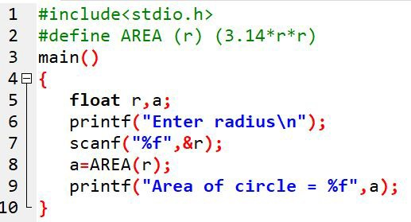

b) Argumented macro
This argumented macro substitution defines macro in more complex and uniform useful forms.
The general form is:
#define identifier (a1,a2,…..) (expression)
Eg:
#define AREA(r) (3.14*r*r)

Slide 23
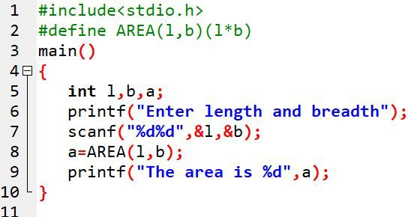
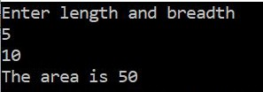
b) Argumented macro - Sample Program

Slide 24
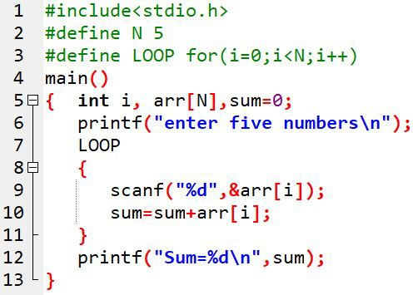
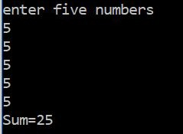
c) Nested macro

Slide 25
2) File Inclusion Directive
are used to include user defined header file inside C programs.
They insert all the contents of the file into the program.
They begin with #include and the header file is mentioned inside double quotes (“ “).

Slide 26
File Inclusion Directive
There are two ways of including header file and they are:
Using angle bracket
The general form is:
#include <filename>
Eg:
#include <stdio.h>
Using double quotes
The general form is:
#include “filename”
Eg:
#include “myfile.c”

Slide 27

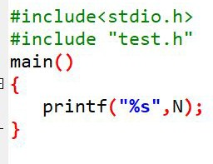

File Inclusion Directive
create a file test.h
Now let us write another program which uses a file inclusion directive.

Slide 28
End of Lecture 12

Slide 29
Pointers

